Slide 2
About Today…
Middleware
Authentication
Error Handling

Slide 3


Slide 4

Intro to Authentication Middleware
Purpose
Verify the identity of a user before granting access to protected routes or
resources
Implementation
Middleware function checks authentication credentials before allowing access

Slide 5
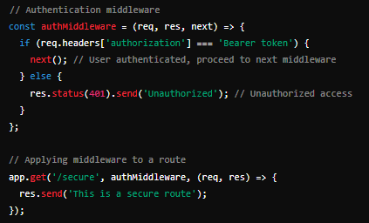

Example of Authentication Middleware

Slide 6

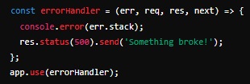
Creating Error Handling Middleware
Error Handling Signature
Middleware with four arguments: (err, req, res, next)
Example Code

Slide 7

Intro to Error Handling Middleware
Definition
Middleware designed to handle errors in an Express application
Purpose
Catch and handle errors, providing a consistent error response

Slide 8

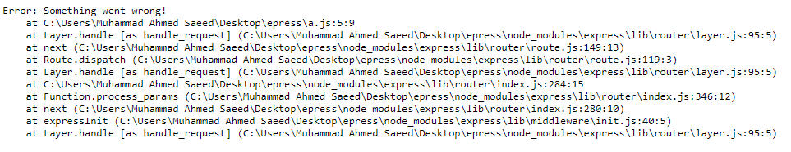
Setting Up Basic Error Handling
Basic Error Handling
Capture errors in routes and pass them to the error-handling middleware
Example Code

Slide 9
Creating Error Handling Middleware
Error Handling Signature
Middleware with four arguments: (err, req, res, next)
Example Code

Slide 10
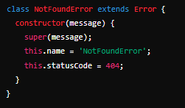
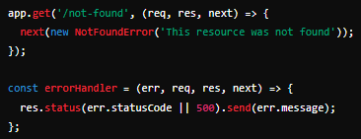
Handling Different Error Types
Custom Error Types
Define different error classes for specific error types
Example Code

Slide 11
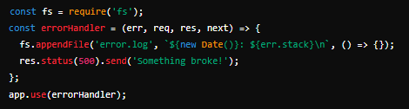
Logging Errors
Importance of Logging
Keep a record of errors for debugging and monitoring
Example Code

Slide 12

What is the role of authentication middleware in an Express.js application?
Verifies the identity of a user before granting access to protected routes or resources
How can you implement authentication middleware in Express.js?
Define a middleware function that checks for valid authentication credentials
Why is error handling middleware important in Express.js?
Catches and processes errors that occur during the request-response cycle
Explain the purpose of using next() in middleware functions.
Passes control to the next middleware function in the stack
How do you apply error handling middleware to an Express.js application?
Use app.use() to apply error handling middleware globally

Slide 13

Task
Implement authentication middleware to protect API routes and error handling middleware to manage and log errors in an Express.js application

